Slide 1
Time Series Project
Dan Tallarico, Ann Eitrheim, and Alvin Haryanto

Slide 2


Problem Statement
Kaggle competition to predict wikipedia web traffic for individual wikipedia web pages
The training dataset consists of approximately 145k time series. Each of these time series represent a number of daily views of a different web page
Predict web page views for a given month using different techniques(auto.arima, sarima,hierarchal, pulse)
Compare techniques across same Wikipedia page topic. What works best for our time series?

Slide 3
Assumptions
No major news would hit during test period on our subject, there will not be a major pulse during this time
There could be other datasets closely related to ours that impact this dataset e.g. Microsoft
Not modeling or factoring in this data
The hosting server was never out for parts of any days in the data set

Slide 4
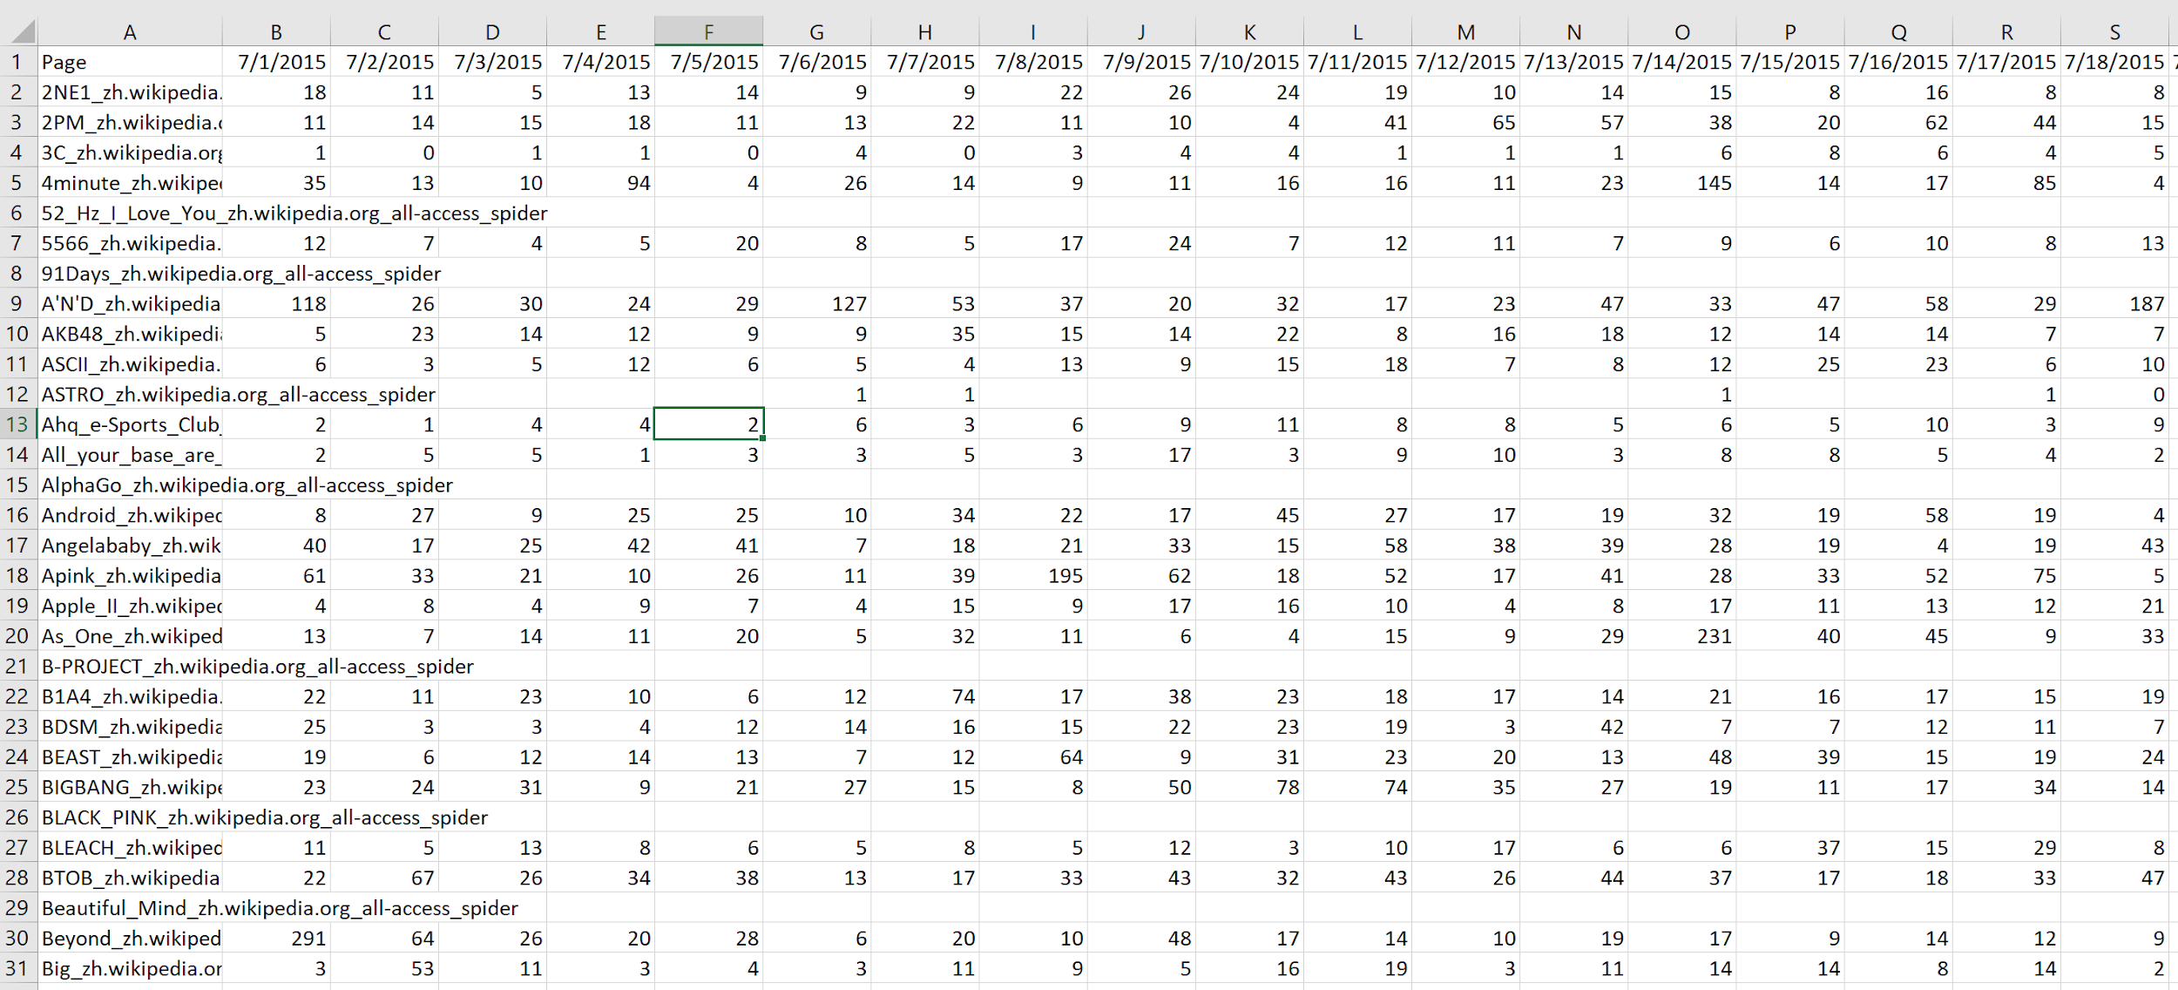
Data Properties & Transformations
Data organized into separate categories
all, mobile, desktop, spider, etc
Languages: English, French, Russian, Spanish, etc
Date range of July 2015 to September of 2017
Transpose data to get into correct time series format
Data is spread out; data from same overarching topic at line 5 and 3000
Created a function used to search dataframe for topics that belong together
Need to convert selected data into a time series format with a week long frequency

Slide 5
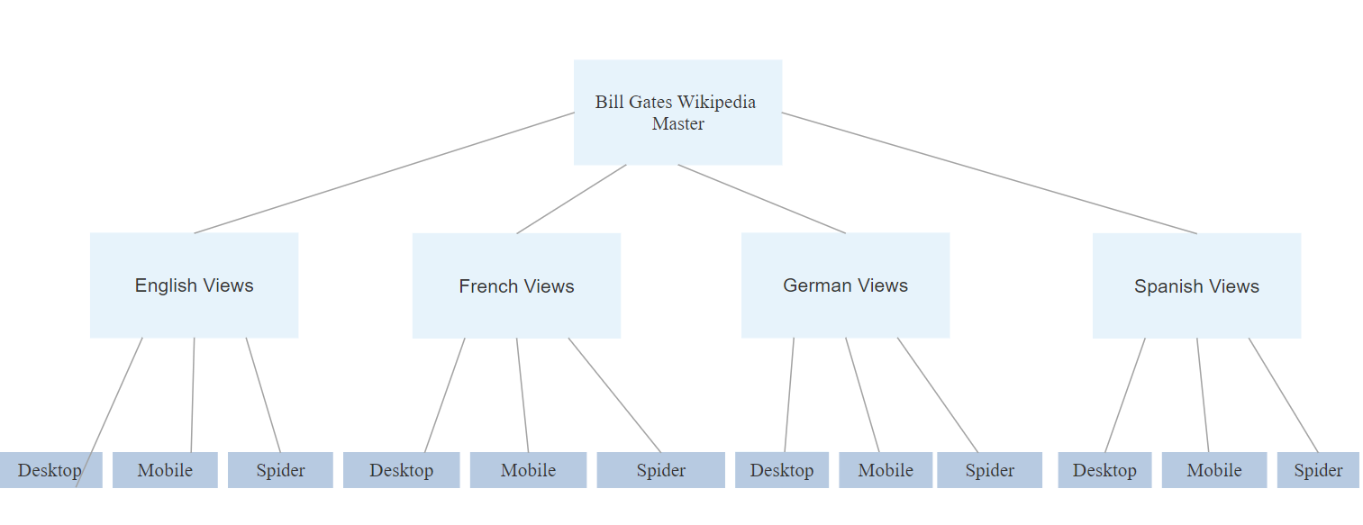
Data Preprocessing
Check for any missing values
Convert data into time series objects with a frequency of 7
Group data by language
Aggregate all languages to get the total traffic of Bill Gates Wikipedia page

Slide 6
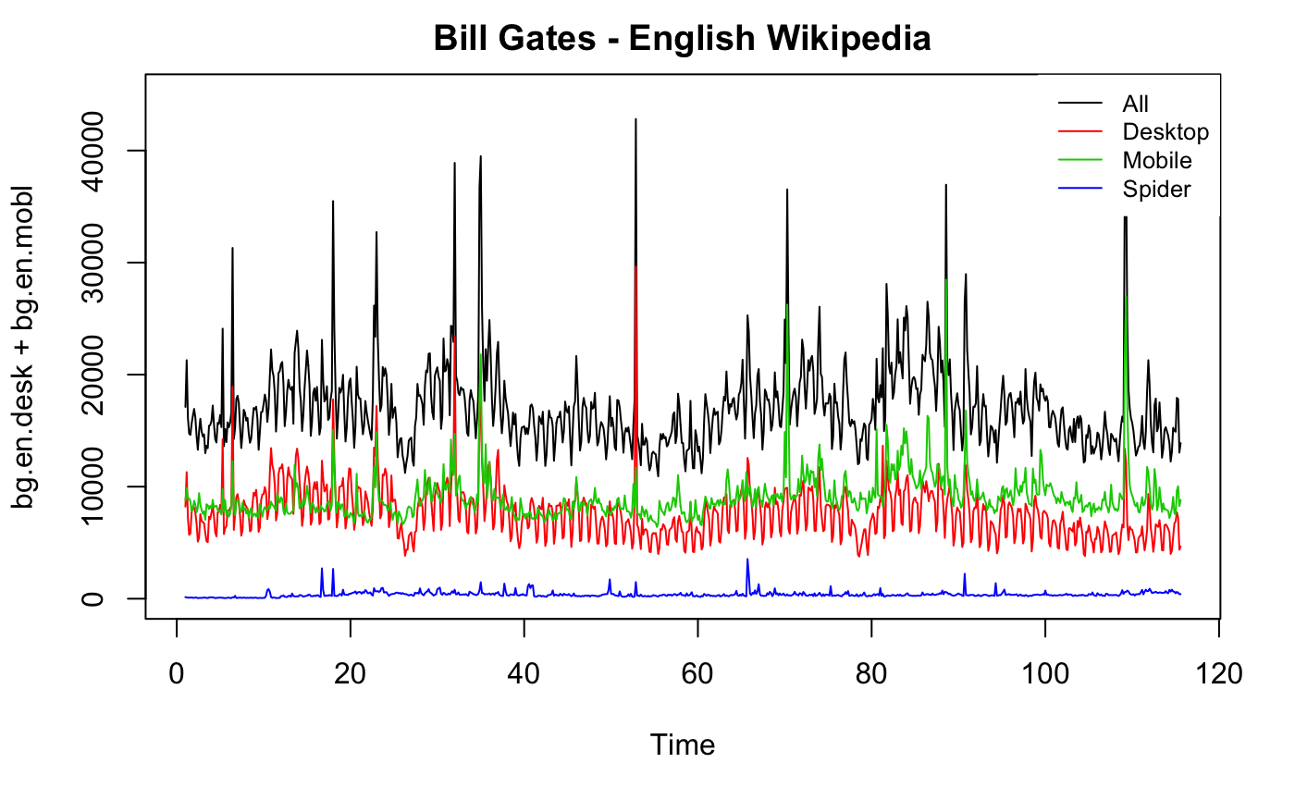
Exploratory Data Analysis
Red is desktop - can tell that has more weekly activity
Blue - spider - web crawler is more consistent
English makes up more than half of the view
Many spikes could be attributed to news on Gates
A few spikes in dataset including in July of 2017 when Gates no longer richest person in the world

Slide 7
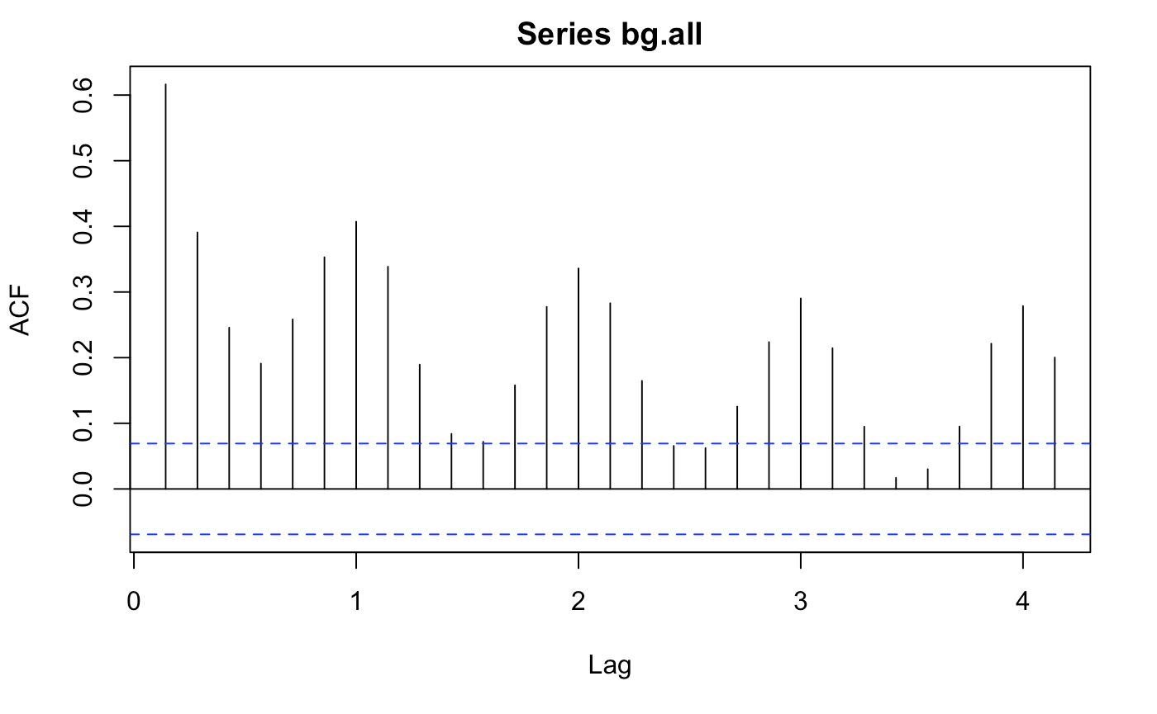
Exploratory Data Analysis
> kpss.test(Bill.Gates.All) p-value = 0.01213
Time series is stationary
Acf shows seasonality

Slide 8


Proposed Approaches (Models)
Bill Gates Wikipedia Page Views
Models
Nonseasonal auto.arima (baseline)
Seasonal auto.arima
Hierarchical
Pulse
Our thesis is bottom’s up hierarchal will produce the best results
Testing last 30 days of dataset
Analysis of 12 time series of data:
French - Desktop, Mobile, Spider
English - Desktop, Mobile, Spider
German - Desktop, Mobile, Spider
Spanish - Desktop, Mobile, Spider

Slide 9
Proposed Solution (Model Selection)

Slide 10
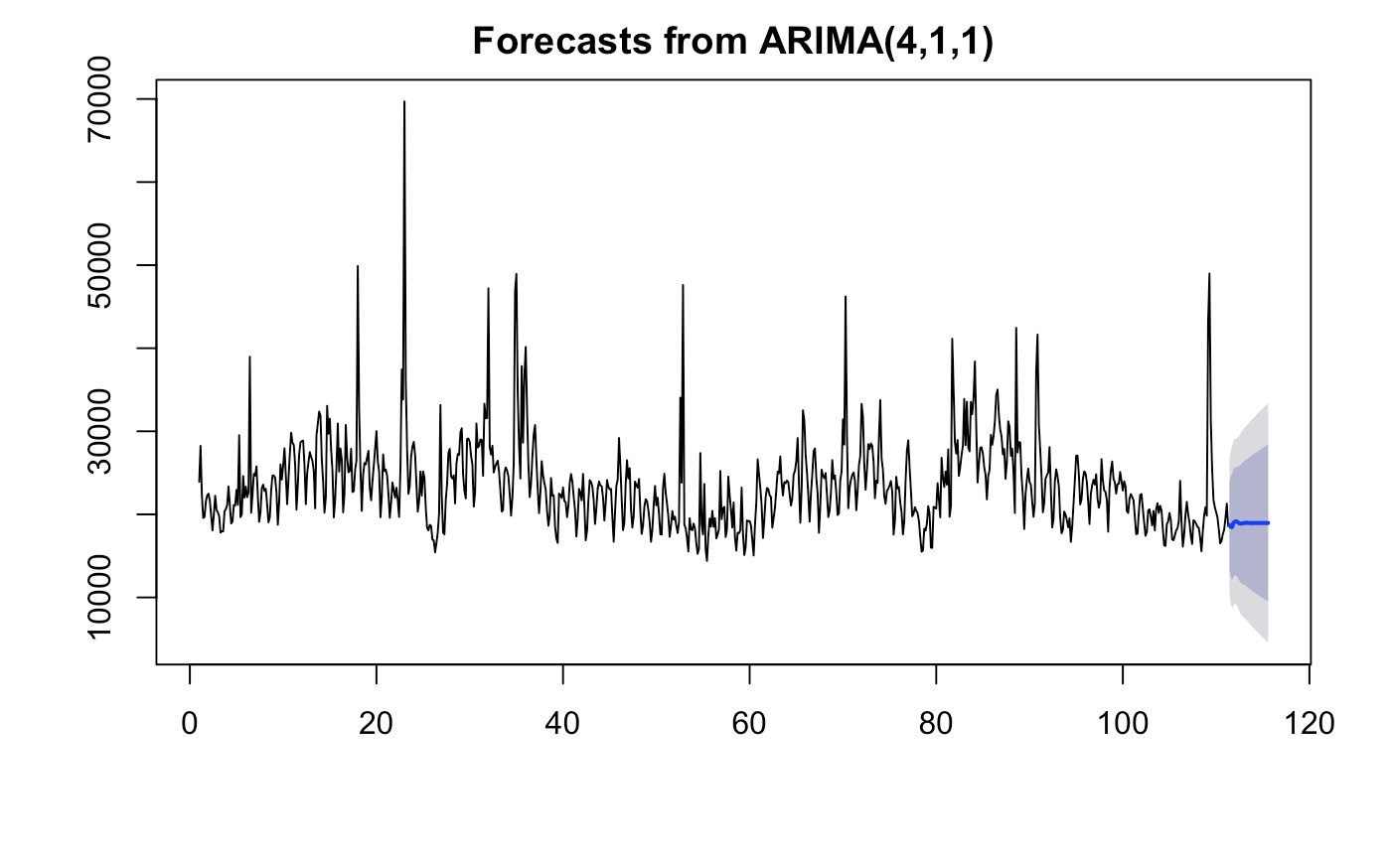
Non-seasonal Arima
> auto.arima(train, seasonal = F, stepwise = F) ARIMA(4,1,1)
AIC: 15,049 Test RMSE: 3,251
Test MAE: 2,531
Test MPE: 6.81

Slide 11
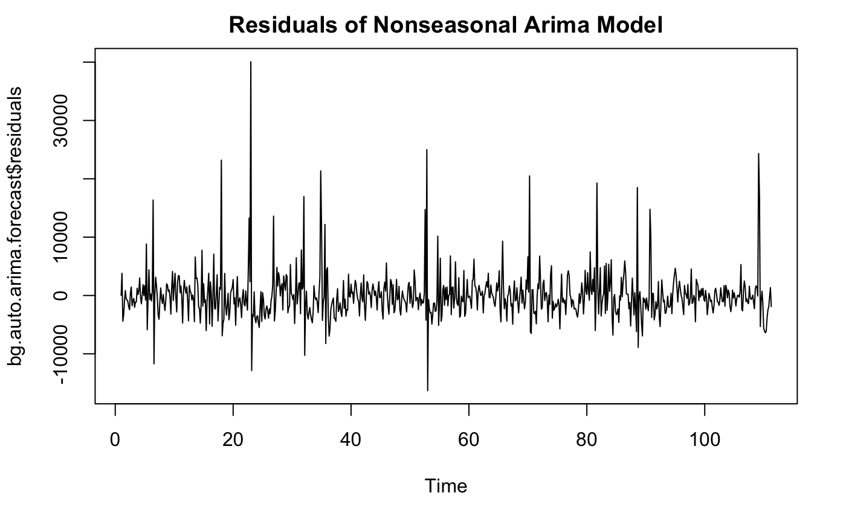
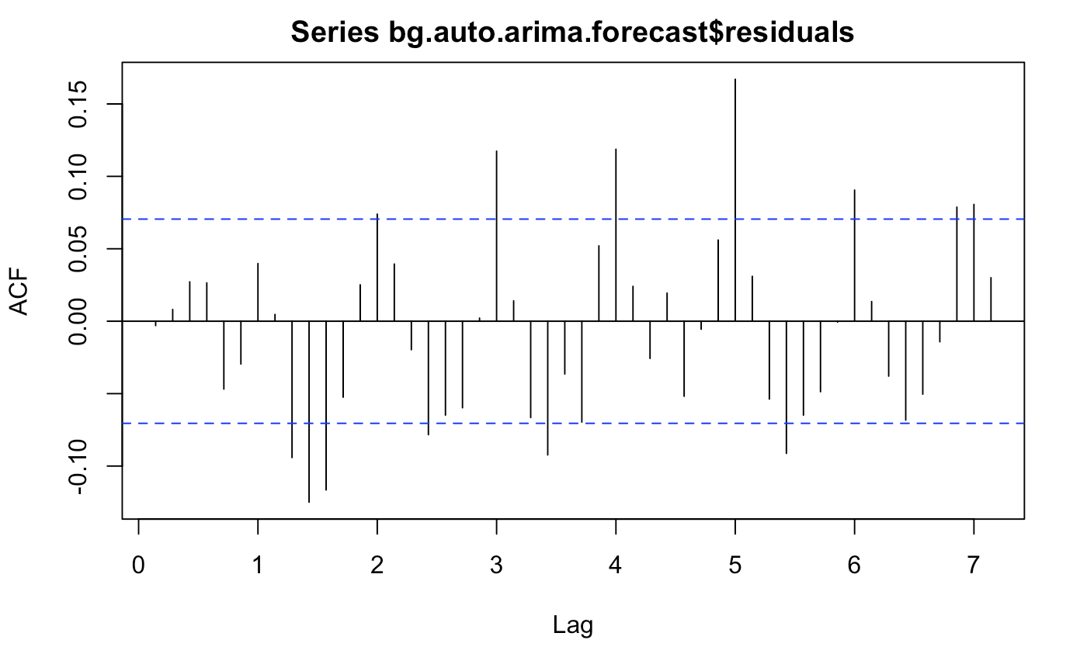
Non-seasonal Arima
>kpss.test(forecast$residuals) p-value = 0.1
>Box.test(forecast$residuals, lag = 14) p-value = 0.0001388
>mean(forecast$residuals) -22.45

Slide 12
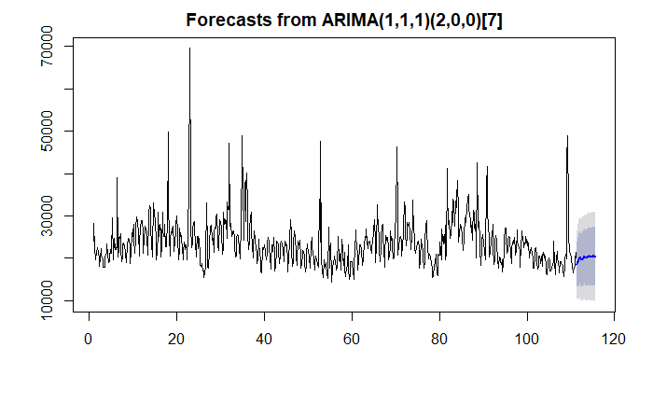
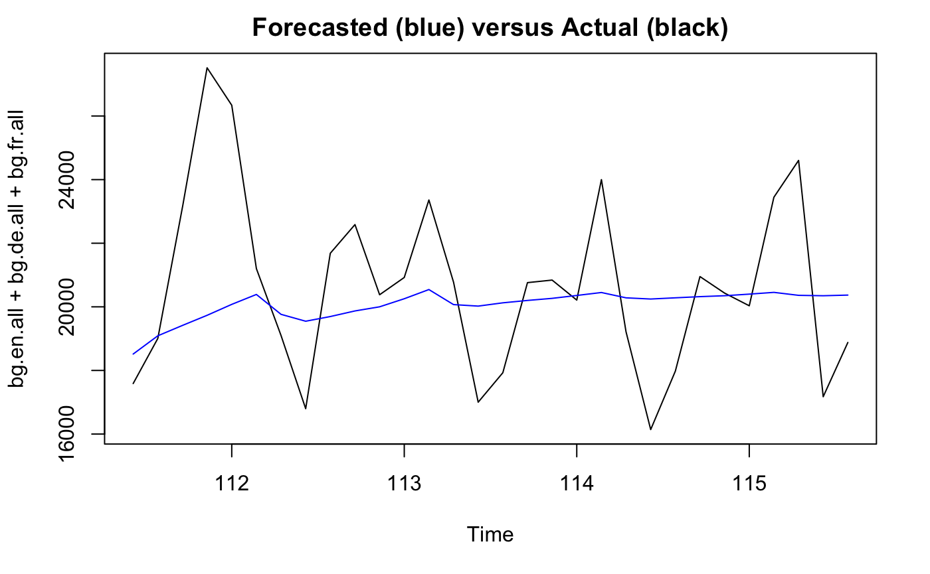
Seasonal Arima
> auto.arima(train, stepwise = F) ARIMA(1,1,1)(2,0,0)[7]
AIC: 15,023 Test RMSE: 2,791
Test MAE: 2,093
Test MPE: 1.30
The forecasted values in blue are less volatiles than the actual swings in number of views

Slide 13
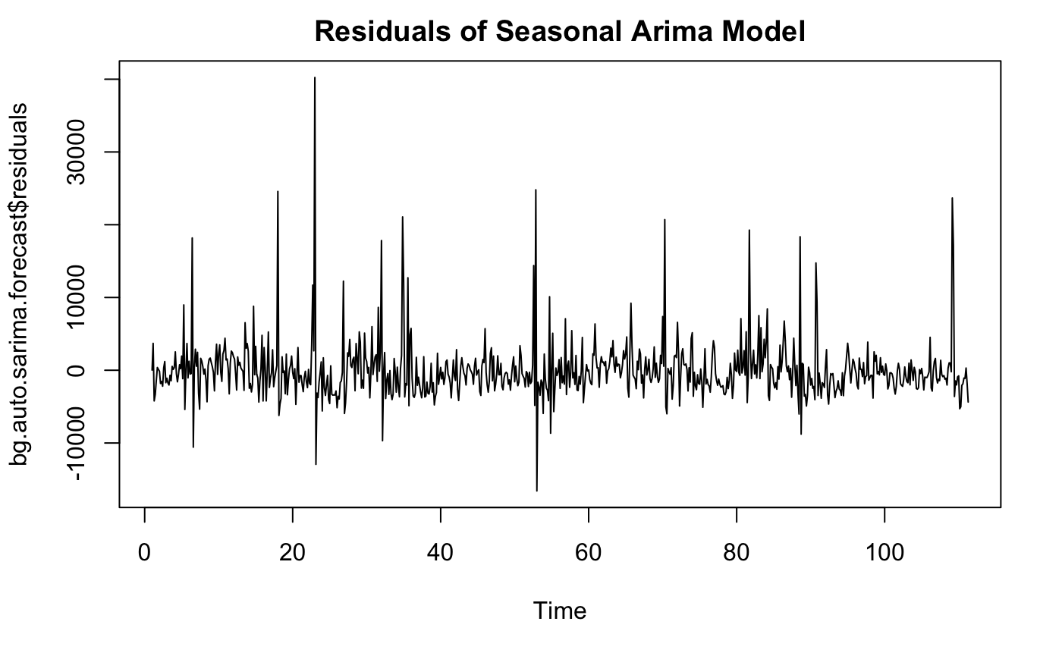
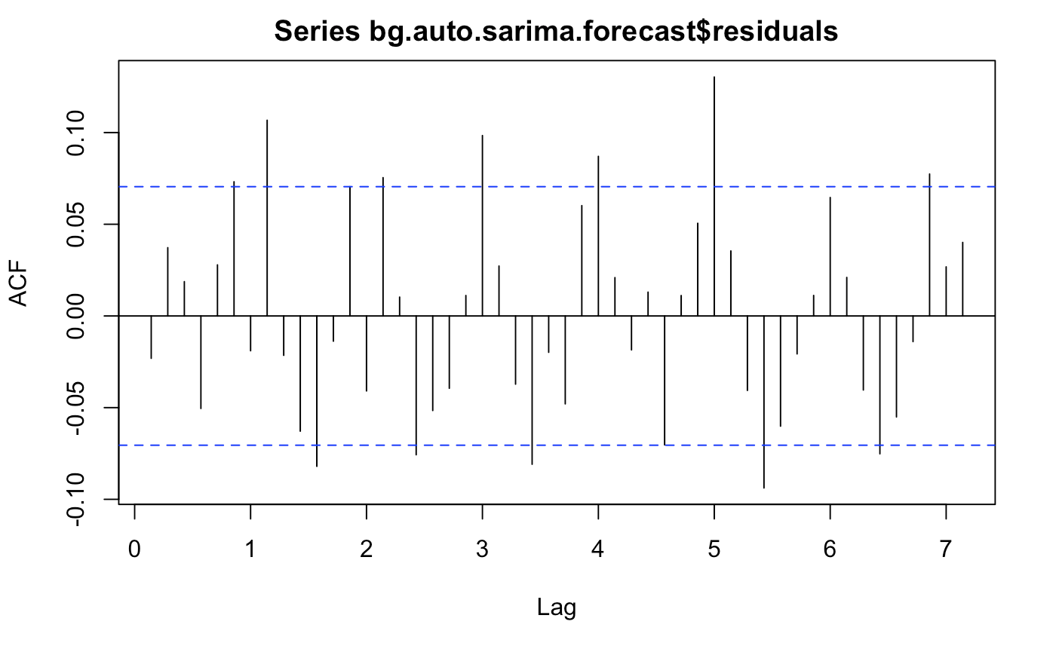
Seasonal Arima
>kpss.test(forecast$residuals) p-value = 0.1
>Box.test(forecast$residuals, lag = 14) p-value = 0.004184
>mean(forecast$residuals) -31.12

Slide 14
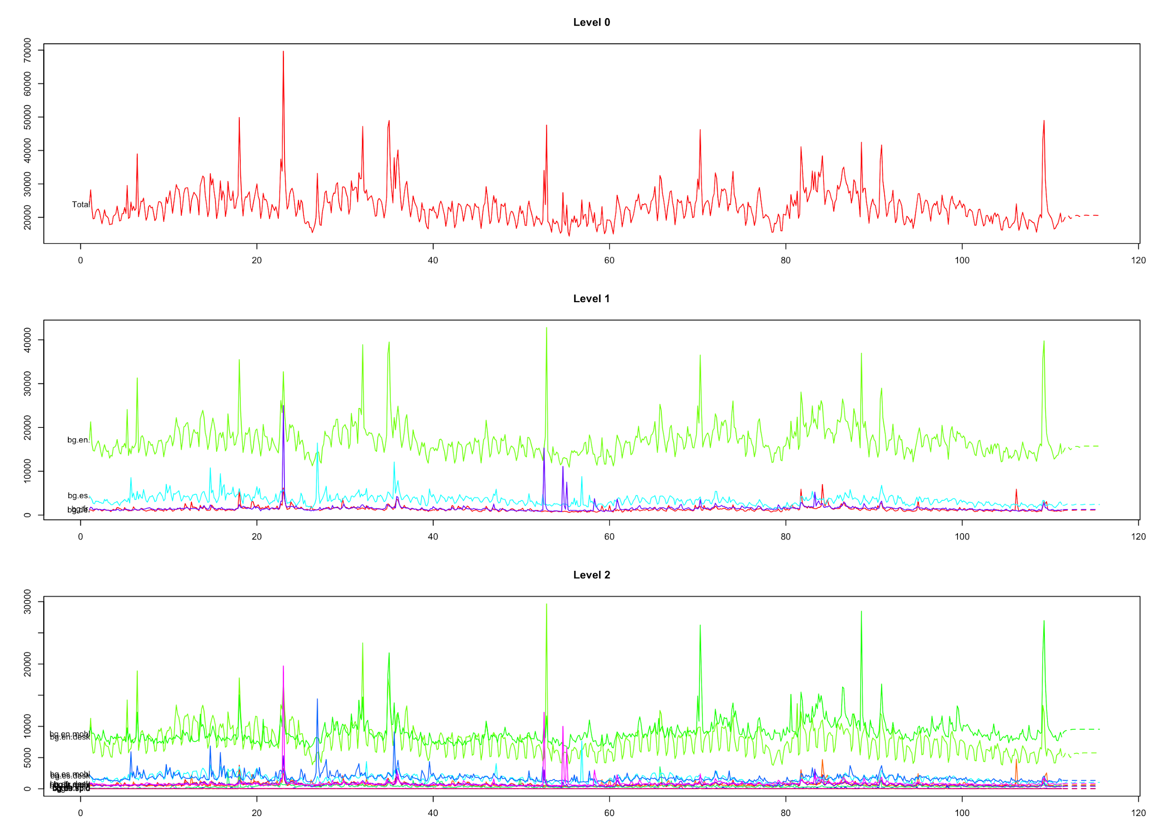
Hierarchical
Bottom-Up Approach gave best results
library("hts")
hts(train, characters = c(6,4))
Character argument: need to be careful on how the time series are named
3 layers
The bottom layer consists of individual prediction for each languages page from each platform (i.e. mobile, spider, desktop)
These predictions are then rolled up into their language and then total views

Slide 15
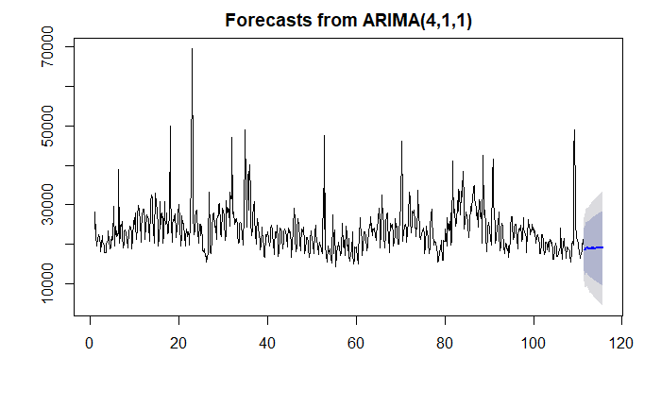
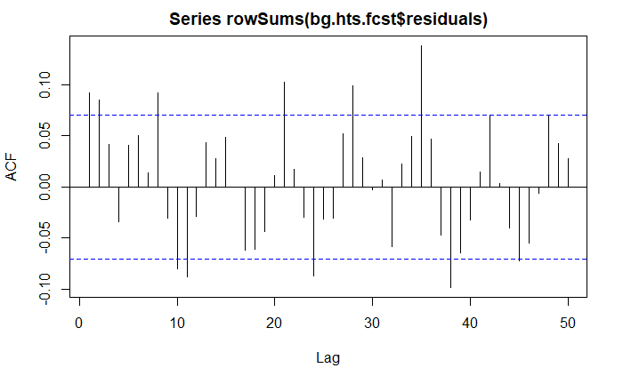
Hierarchical (Forecast and Accuracy)
>accuracy.gts(bg.hts.fcst, test, level = 0)
Level zero refers to aggregated time series
Test RMSE: 2,686
Test MAE: 2,041
Test MPE: -0.12

Slide 16
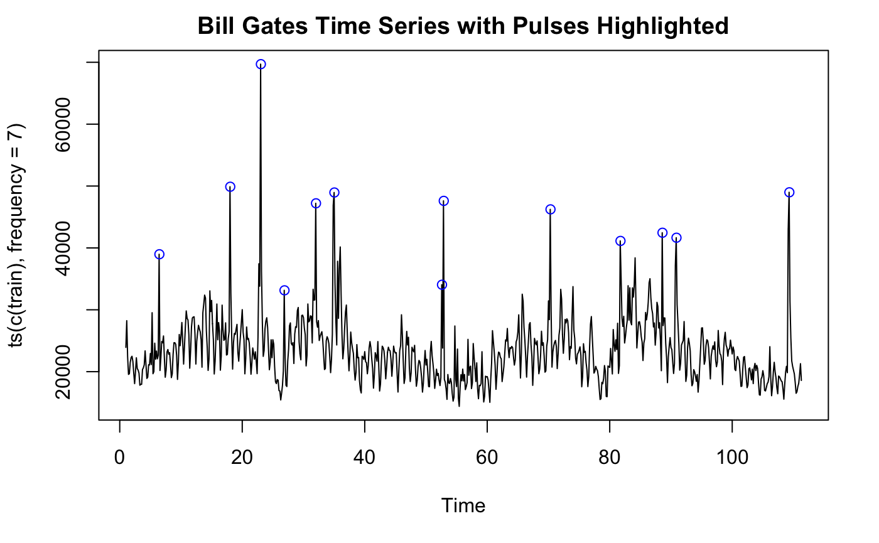
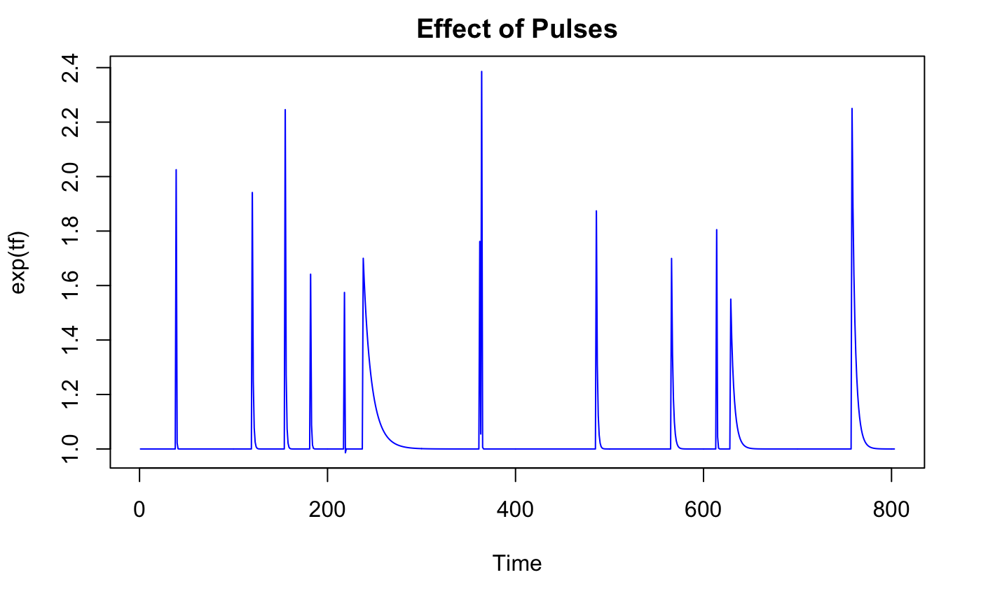
Pulse
13 pulses in the time series (train)

Slide 17
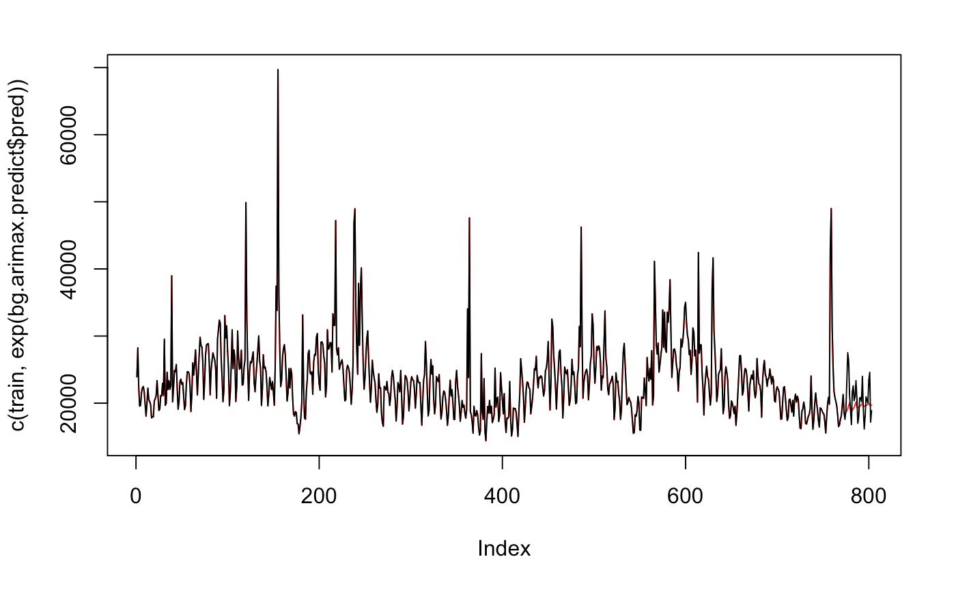
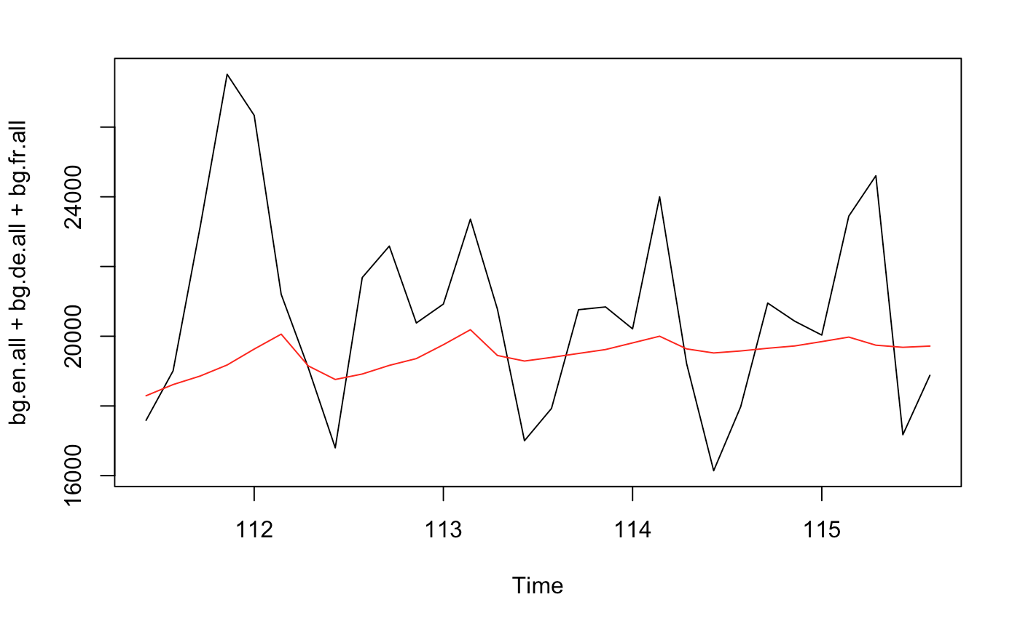
Pulse
> arimax() > filter() > Arima() > predict()
AIC: 1,298 Test RMSE: 3,728
Test MAE: 2,876
Test MPE: 11.9

Slide 18
Results (Accuracy)
Recommendation: Hierarchical model
Slightly better than SARIMA, out edges out in all major metrics
Hierarchical is more time consuming so as dataset gets larger it will be less computationally efficient
Validation of Test/Holdout | Non-Seasonal Arima | Seasonal Arima | Hierarchical | Pulse Intervention
Mean Absolute Error | 2530.8 | 2092.5 | 2041.4 | 2876.5
Mean Percent Error | 6.81 | 1.30 | -0.12 | 11.94
Root Mean Square Error | 3251.0 | 2791.2 | 2686.0 | 3727.5

Slide 19
Future Work
Test out the models on different time series in the dataset
Fourier model
Try various number of pulses
Are certain models consistently better for this type of problems?
Compare accuracy of this prediction with a neural net on entire data set
Would modeling the rest of the time series create a better prediction? Is there any relationship between time series
Leader in Kaggle competition used a RNN seq2seq model.

Slide 20


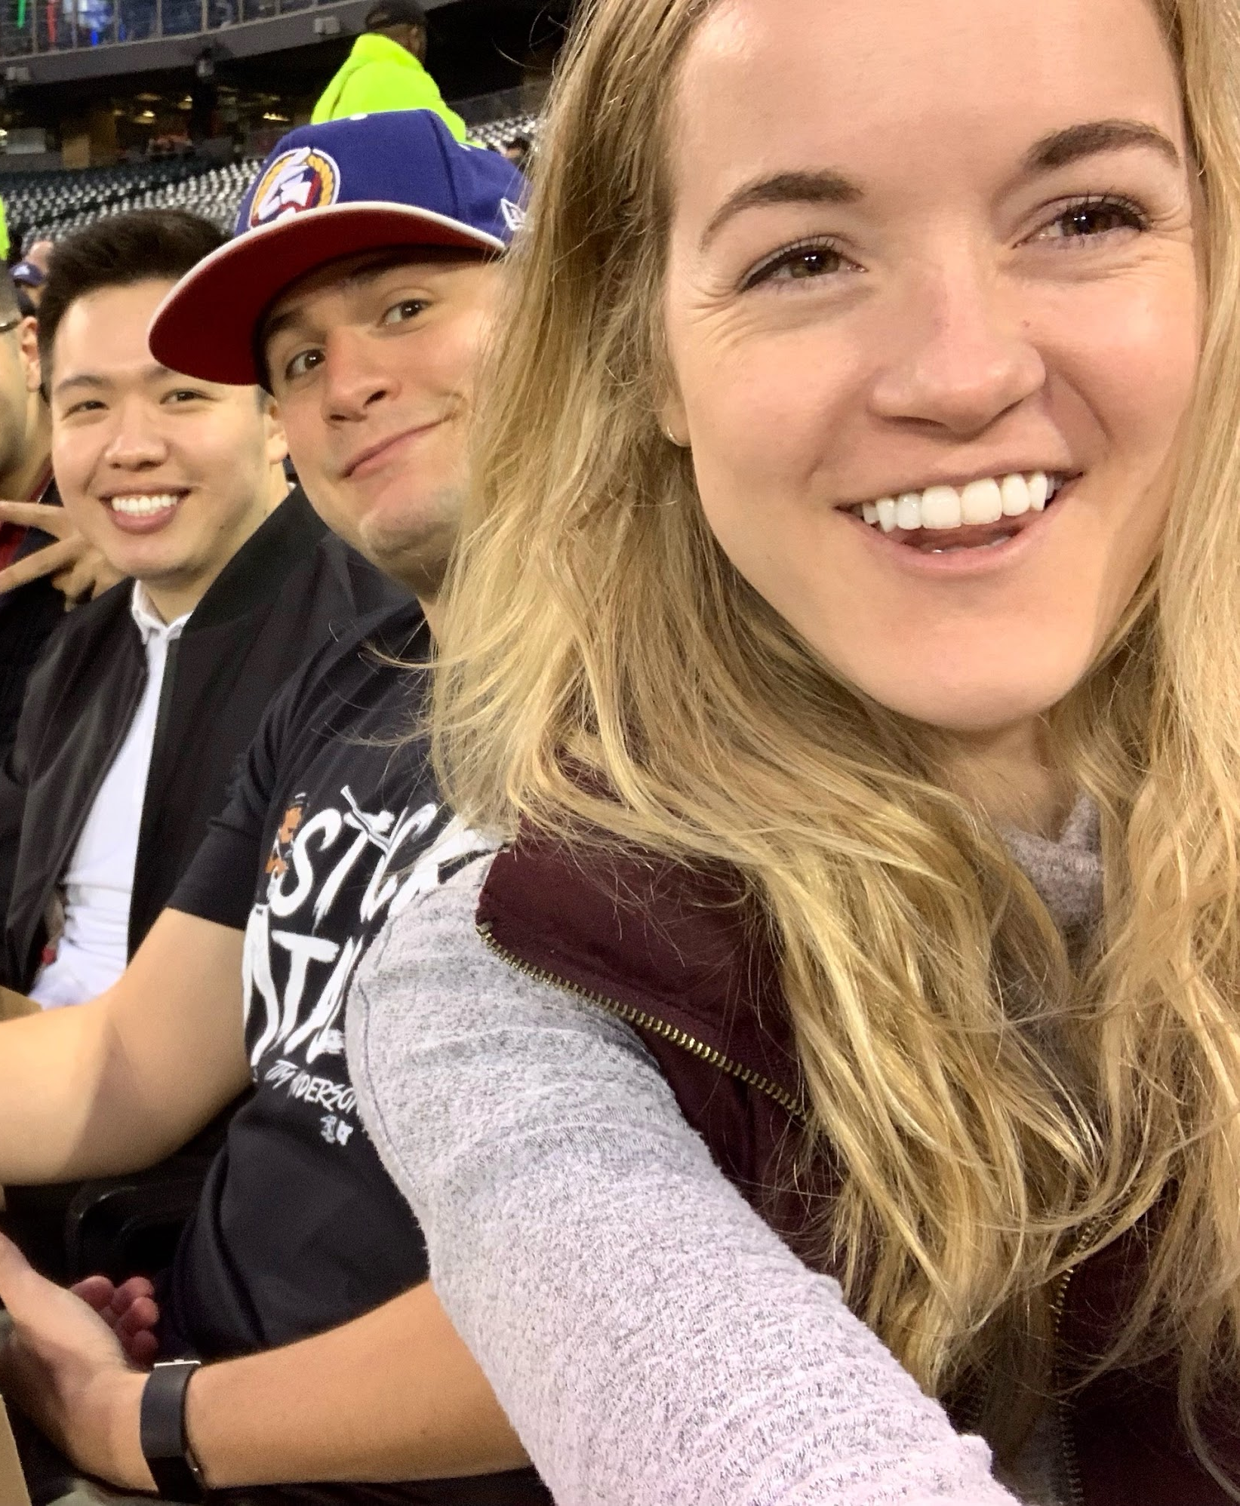
Thank you

Slide 21
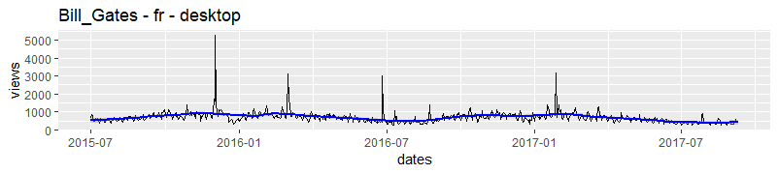
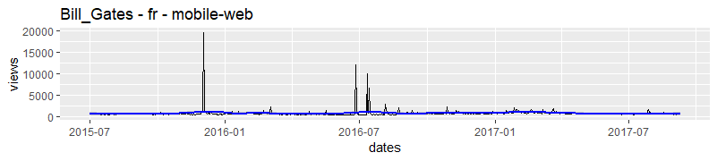
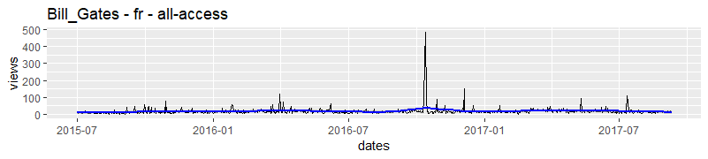

Slide 22
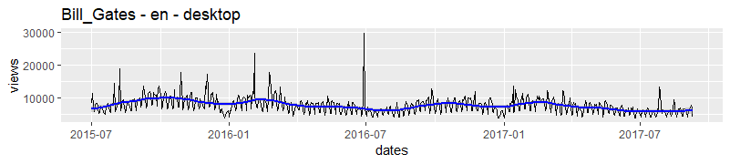
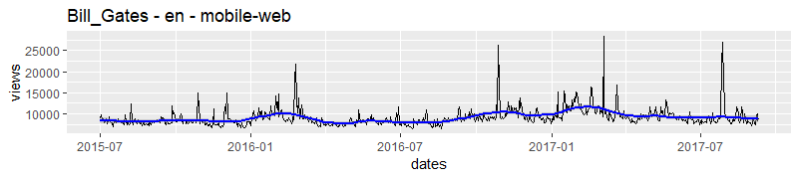
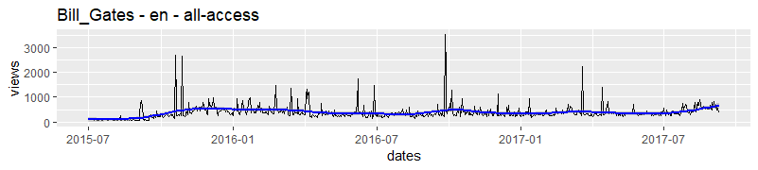

Slide 23
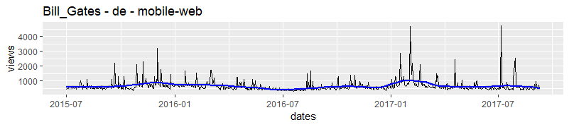
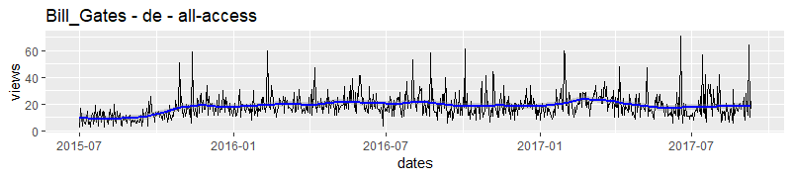
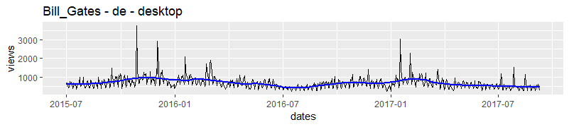

Slide 24
